Slide 1

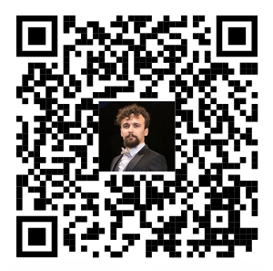








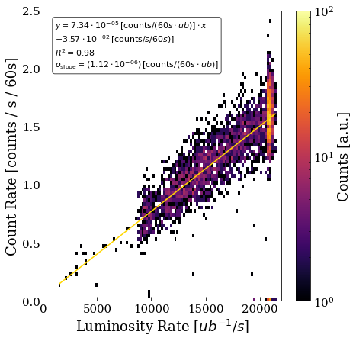
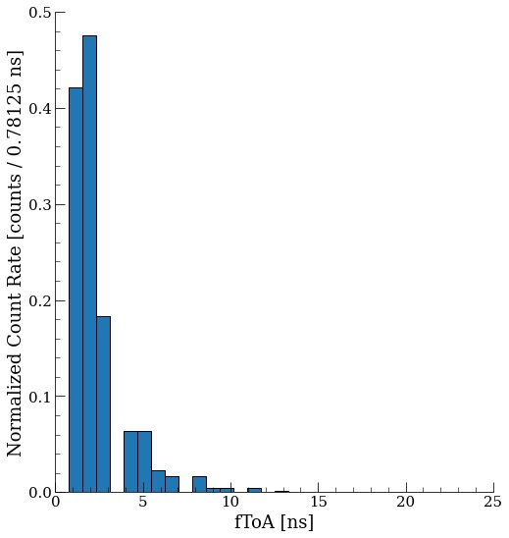
Measurement of the Muon Rate at the SND Experiment
with the Timepix3 Radiation Monitor
Emanuela Revani^{1,2}, Daniel Prelipcean^{1,*}, Giuseppe Lerner¹, James Storey¹, Simona Ilieva Ilieva¹
¹CERN (CH-1211 Geneva), ²Constructor University (28759 Bremen), *Corresponding author: daniel.prelipcean@cern.ch
1. Introduction
5. Timepix3 Count rate
Using the Timepix3 Radiation Monitor [1], a test campaign at the Scattering and Neutrino Detector (SND) [2] location in the Large Hadron Collider (LHC) was performed, aiming to measure the muon rate during proton-proton (pp) luminosity production at the ATLAS Interaction Point 1 (IP1).
The results are compared with both dedicated simulations performed with the FLUKA.CERN [3–5] simulation code and the SND@LHC measurements [6].
Operationally, the LHC fill stages [10], start with injection of the proton bunches, accelerating and then colliding the two beams, thereby producing the instantaneous luminosity L_{inst}. Seven fills were successfully measured, and after isolating the muon signal, the measured Timepix3 muon rate 𝛟_{μ} is:
𝛟_{μ}^{Timepix3}=(4.88 ± 0.78) · 10⁴ counts/(fb⁻¹·cm²)
where an effective count rate is obtained by considering the orientation of the Timepix, and a uniform irradiation over the detector’s area A=2.14 cm². The contributing sources of uncertainty are: the Poisson measurement statistics of the Timepix3 detector ΔΦ = 14%, the fitting result of Δ _{𝑓 𝑖𝑡} = 2% and the luminosity measurement uncertainty assumed at ΔL = 2% [10].
2. Muon Filtering Steps
1. Muons behave like Minimum lonizing Particles (MIPs) in the energy range of≈ 100 GeV, thereby leaving straight tracks in Timepix3 detector [7,8]. As such, only these straight tracks are retained.
2. Due to the detector orientation, the straight tracks are expected around an azimuth angle of φ=(90 ± 26.57)°, but considering as well possible misalignments with the Line of Sight (LOS) from IP1.
3. Considering the orientation of the detector at Θ₀ = 39.1° the maximum cluster length (L) that a muon can have is 6 pixels. Therefore, clusters with a length of L = 3 up to 6 were considered.
3. Muon Energy Deposition Distribution
Most of the muons have an energy of 100 GeV [2], corresponding to a linear energy transfer (LET) of dE/dx|_{Si} = 6.5 MeV/cm in Silicon [9]. Given the incidence angle Θ₀, the expected energy deposition in the detector is found to be E_{dep}≈ 209 keV, assuming a muon passing, through 6 pixels. The Timepix3 Radiation Monitor measures a Time-over- Threshold (TOT) distribution for the muon beam, with a Gaussian peak of:
4. Bunch-by-bunch resolution
Fig. 1: Timepix3 particle rate 𝛟_{μ} plotted against the instantaneous delivered luminosity L_{inst} at IP1, revealing a linear correlation.
The Timepix3 detector has a ToA time resolution of 25 ns, matching the LHC bunch spacing [10], and a fast Time-of-Arrival (fToA) clock with a refined resolution of 1.625 ns. ​
A clear structure in the beam is observed as most of the particles arrive with low fToA values, showing that the Timepix3 Radiation Monitor can measure the bunched beam over longer periods of time; however, a bunch-by-bunch instantaneous measurement is not possible as the count rate is not high enough to yield a strong enough signal.​
The measured Timepix3 muon flux agrees within uncertainty with the SND muon flux measured in 2024 at:
𝛟_{μ}^{SND@LHC}=(4.16 ± 0.19) · 10⁴ counts/(fb⁻¹·cm²)
where the error bar is given by the quadrature sum of statistical and systematic ones, where for the latter the ΔL = 2% uncertainty on the IP1 luminosity is assumed, and Δ𝜀_{𝑆𝑐𝑖𝐹𝑖}=4% SciFi tracking efficiency uncertainty. Moreover, the FLUKA simulated values is reported [11] at:
𝛟_{μ}^{FLUKA}=4.79 · 10⁴ counts/(fb⁻¹·cm²)
5. Conclusions
The Timepix3 Radiation Monitor detector successfully measured the muon rate at the SND experiment, located around IP1 of the LHC.
After applying selection filters, the measured muon flux was determined, matching the SND@LHC muon flux measured in 2024, and the FLUKA simulated one.
The energy deposition is consistent with the expected 100 GeV muons coming from IP1.
Considering the bunch-by-bunch resolution analysis, a clear structure of the beam was observed in the measured fToA values, as most of the particles arrive with low or close to zero fToA values.
Fig. 2: The fToA distribution of the filtered muon rate, as measured by the Timepix3 Radiation Monitor. One fToA unit corresponds to 1.5625 ns.
References
D. Prelipcean et al, Towards a Timepix3 Radiation Monitor for the Accelerator Mixed Radiation Field: Characterisation with Protons and Alphas from 0.6 MeV to 5.6 MeV. in Applied Sciences 14, no. 2: 624, January 2024. DOI: 10.3390/app14020624.
SND Collaboration, “SND@LHC - Scattering and Neutrino Detector at the LHC”, CERN, Tech. Rep. CERN-LHCC-2021-003. LHCC-P-016, 2021. https://cds.cern.ch/record/2750060.
FLUKA website. URL https://fluka.cern.
FLUKA.CERN Collaboration. New Capabilities of the FLUKA Multi-Purpose Code. Frontiers in Physics, 9, 2022. ISSN 2296-424X. URL https://www.frontiersin.org/article/10.3389/fphy.2021.788253 .
FLUKA.CERN Collaboration. Overview of the FLUKA code. Annals Nucl. Energy, 82:10–18, 2015. DOI: 10.1016/j.anucene.2014.11.007.
S. Ilieva, Observations and Simulations of Background to SND, Available at: https://indico.cern.ch/event/1431148/, 2024
D. Prelipcean, “Study of the radiation background and of new monitoring tools at the LHC for Run 3 and the HL-LHC. Untersuchung des Strahlungshintergrunds und neuer Überwachungsinstrumente am LHC für Run 3 und HL-LHC”, Presented 30 Jan 2025, 2025. https://cds.cern.ch/record/2928063​
B. Bergmann et al, “Characterization of the radiation field in the atlas experiment with timepix detectors”, IEEE Transactions on Nuclear Science, vol. 66, no. 7, pp. 1861–1869, 2019.doi:10.1109/TNS.2019.2918365
NIST database, Pstar : Stopping power and range tables for protons, https://physics.nist.gov/PhysRefData/Star/Text/PSTAR.html
O. S. Brüning et al., LHC Design Report, CERN Yellow Report, 2004. doi:10.5170/CERN-2004-003-V-1
F. Cerutti, FLUKA studies of muon background towards FASER and SND, Available at: https://indico.cern.ch/event/1431148/, 2024.

